Slide 1

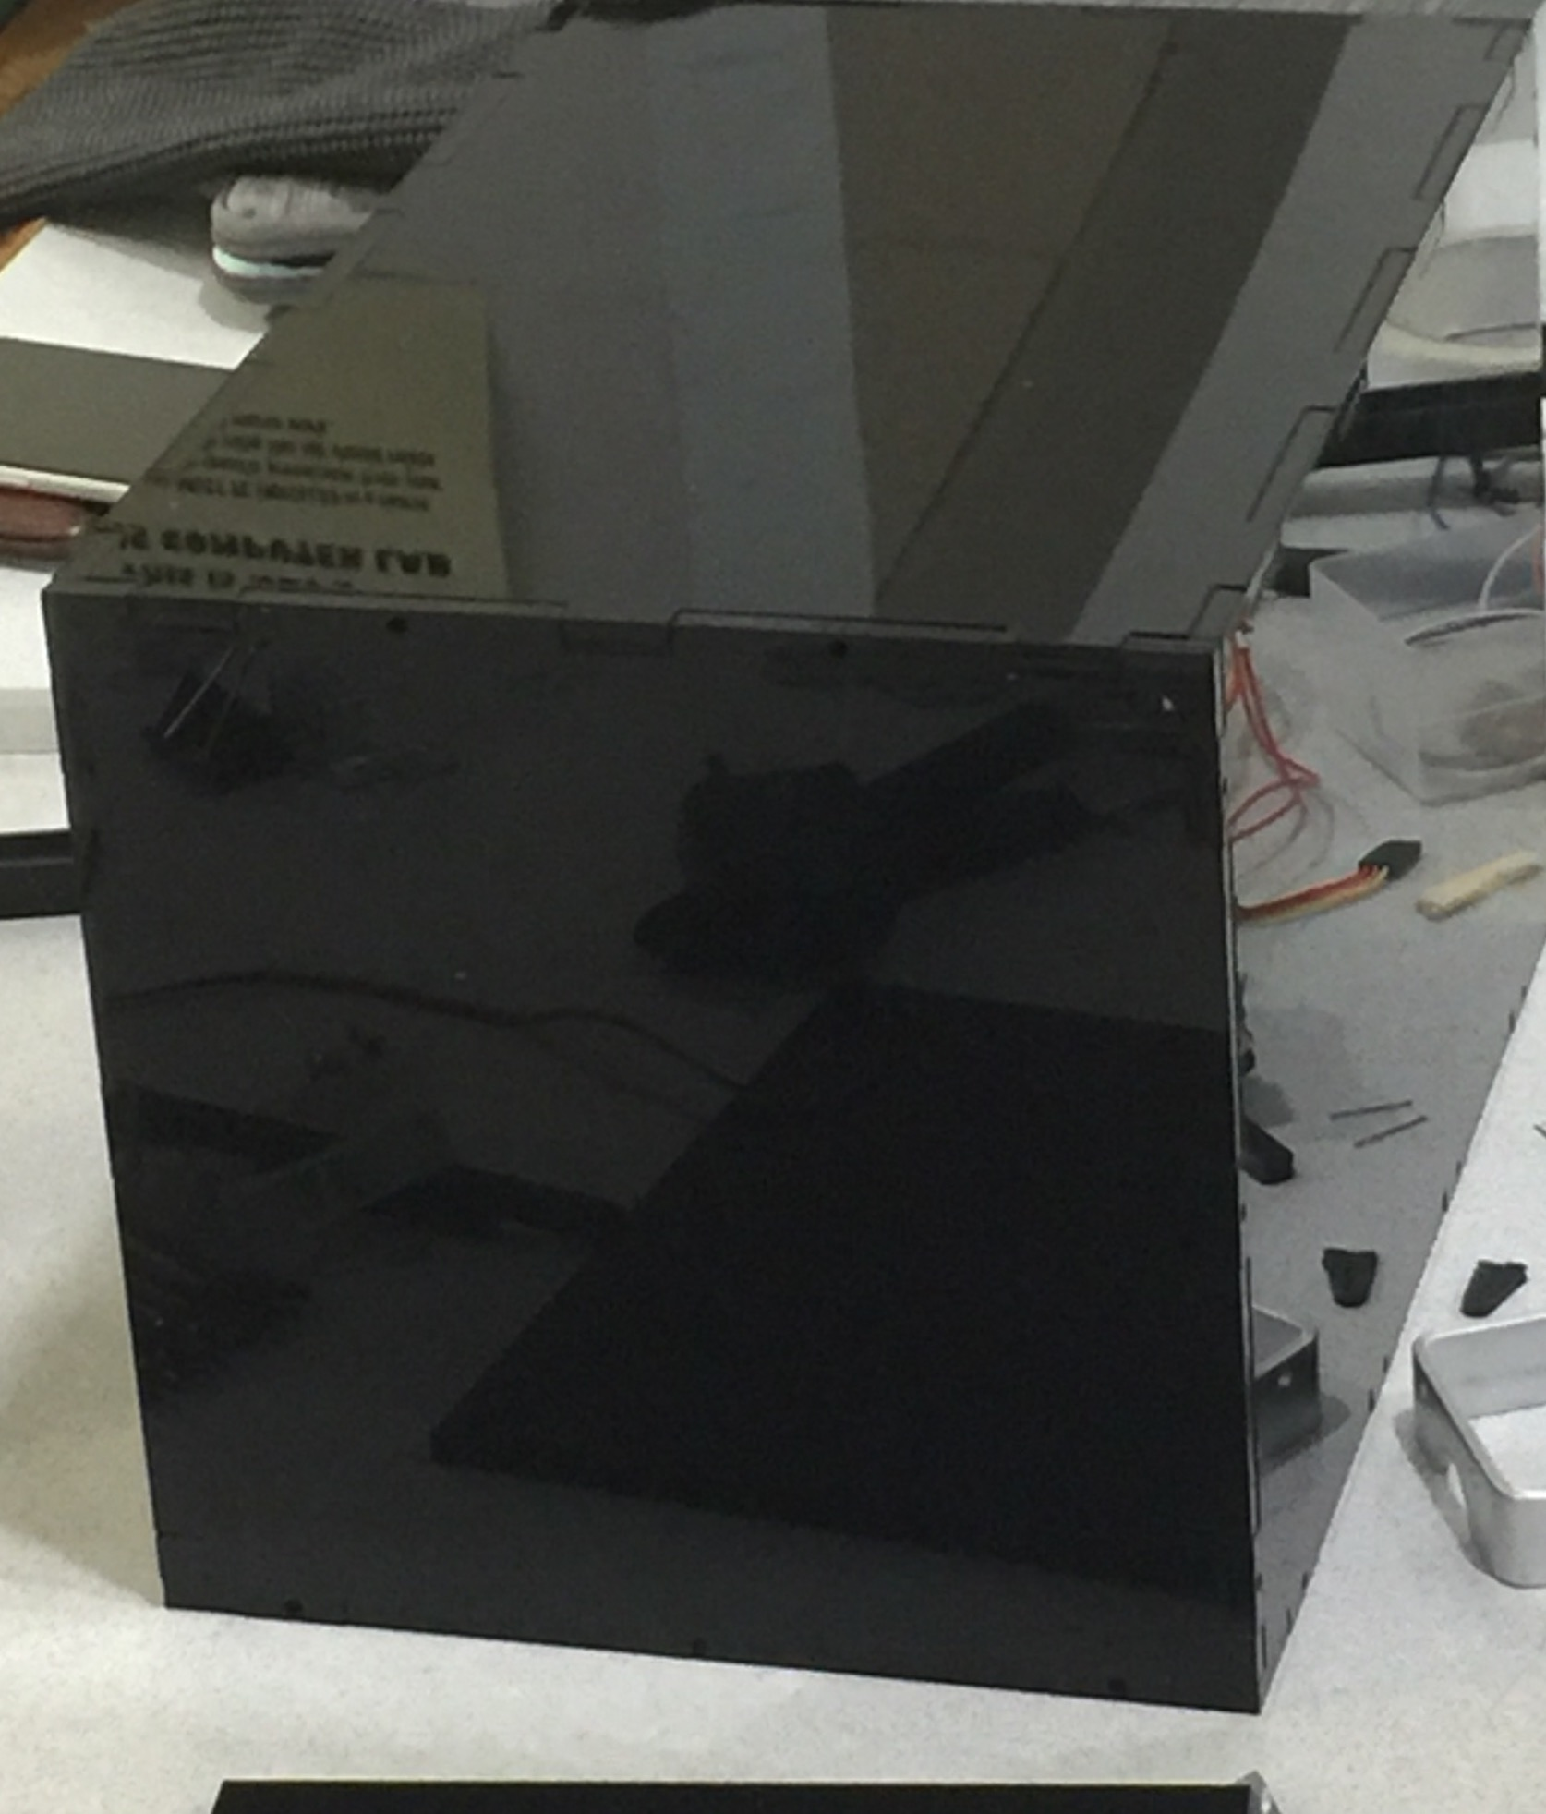
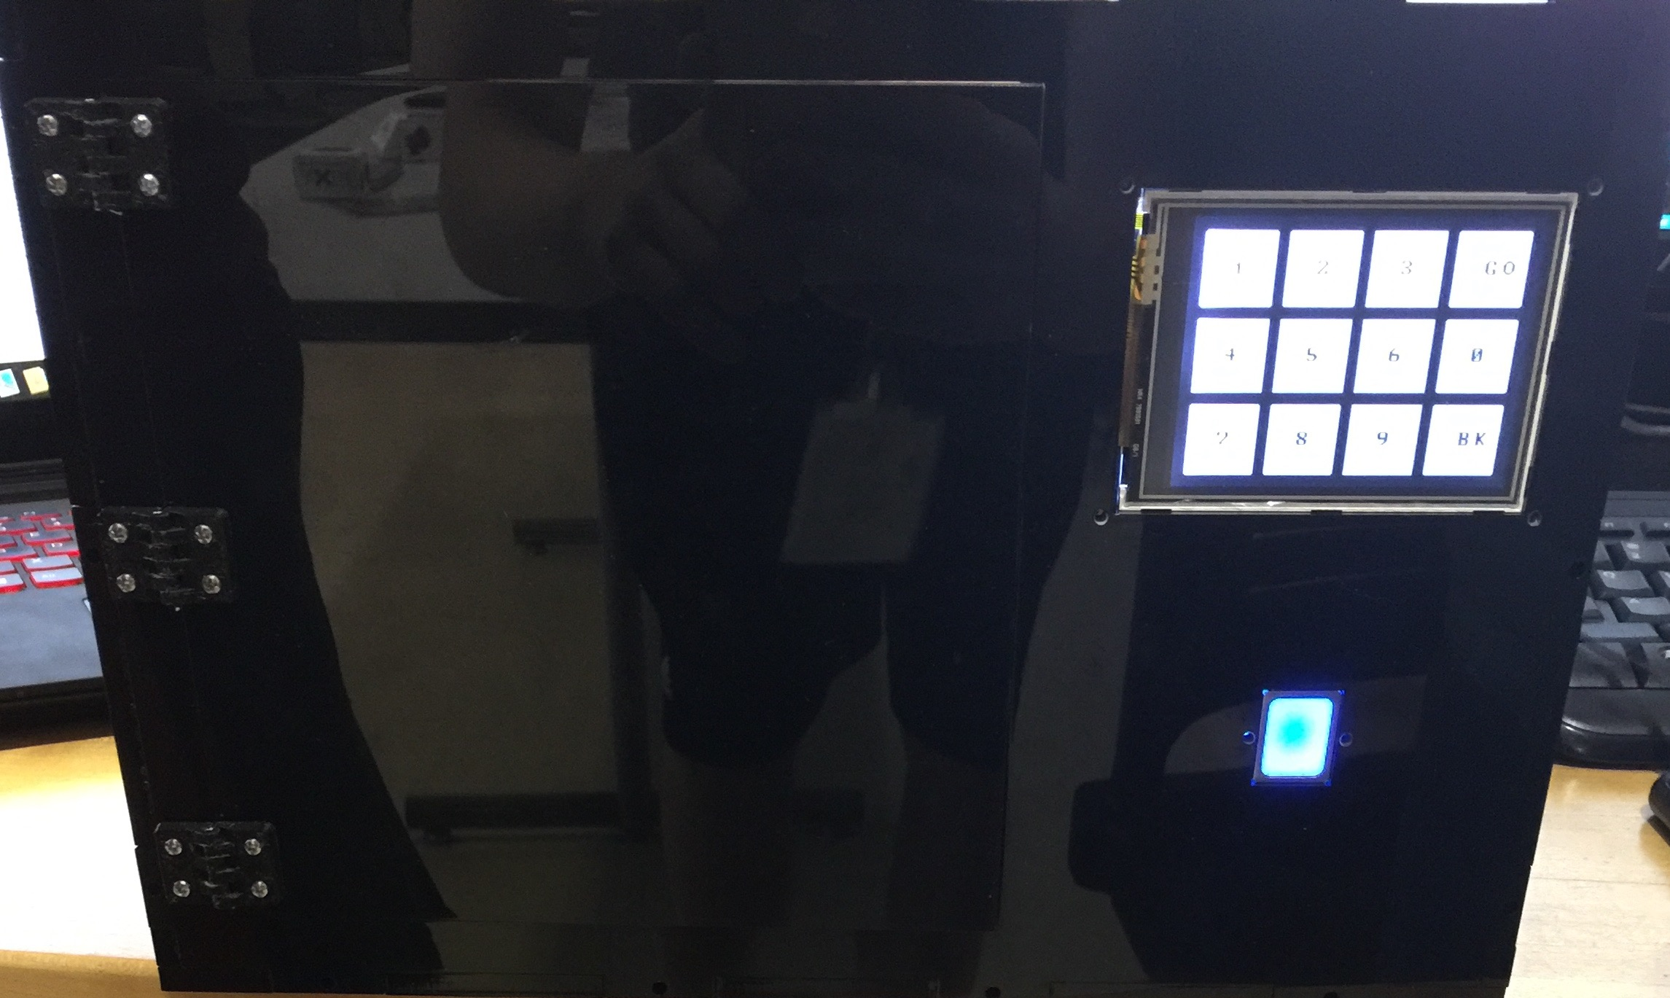
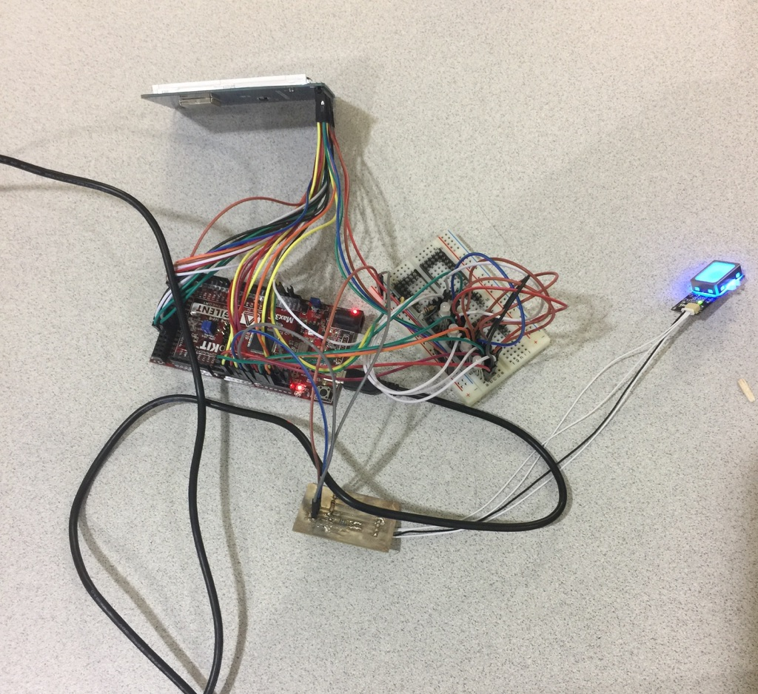
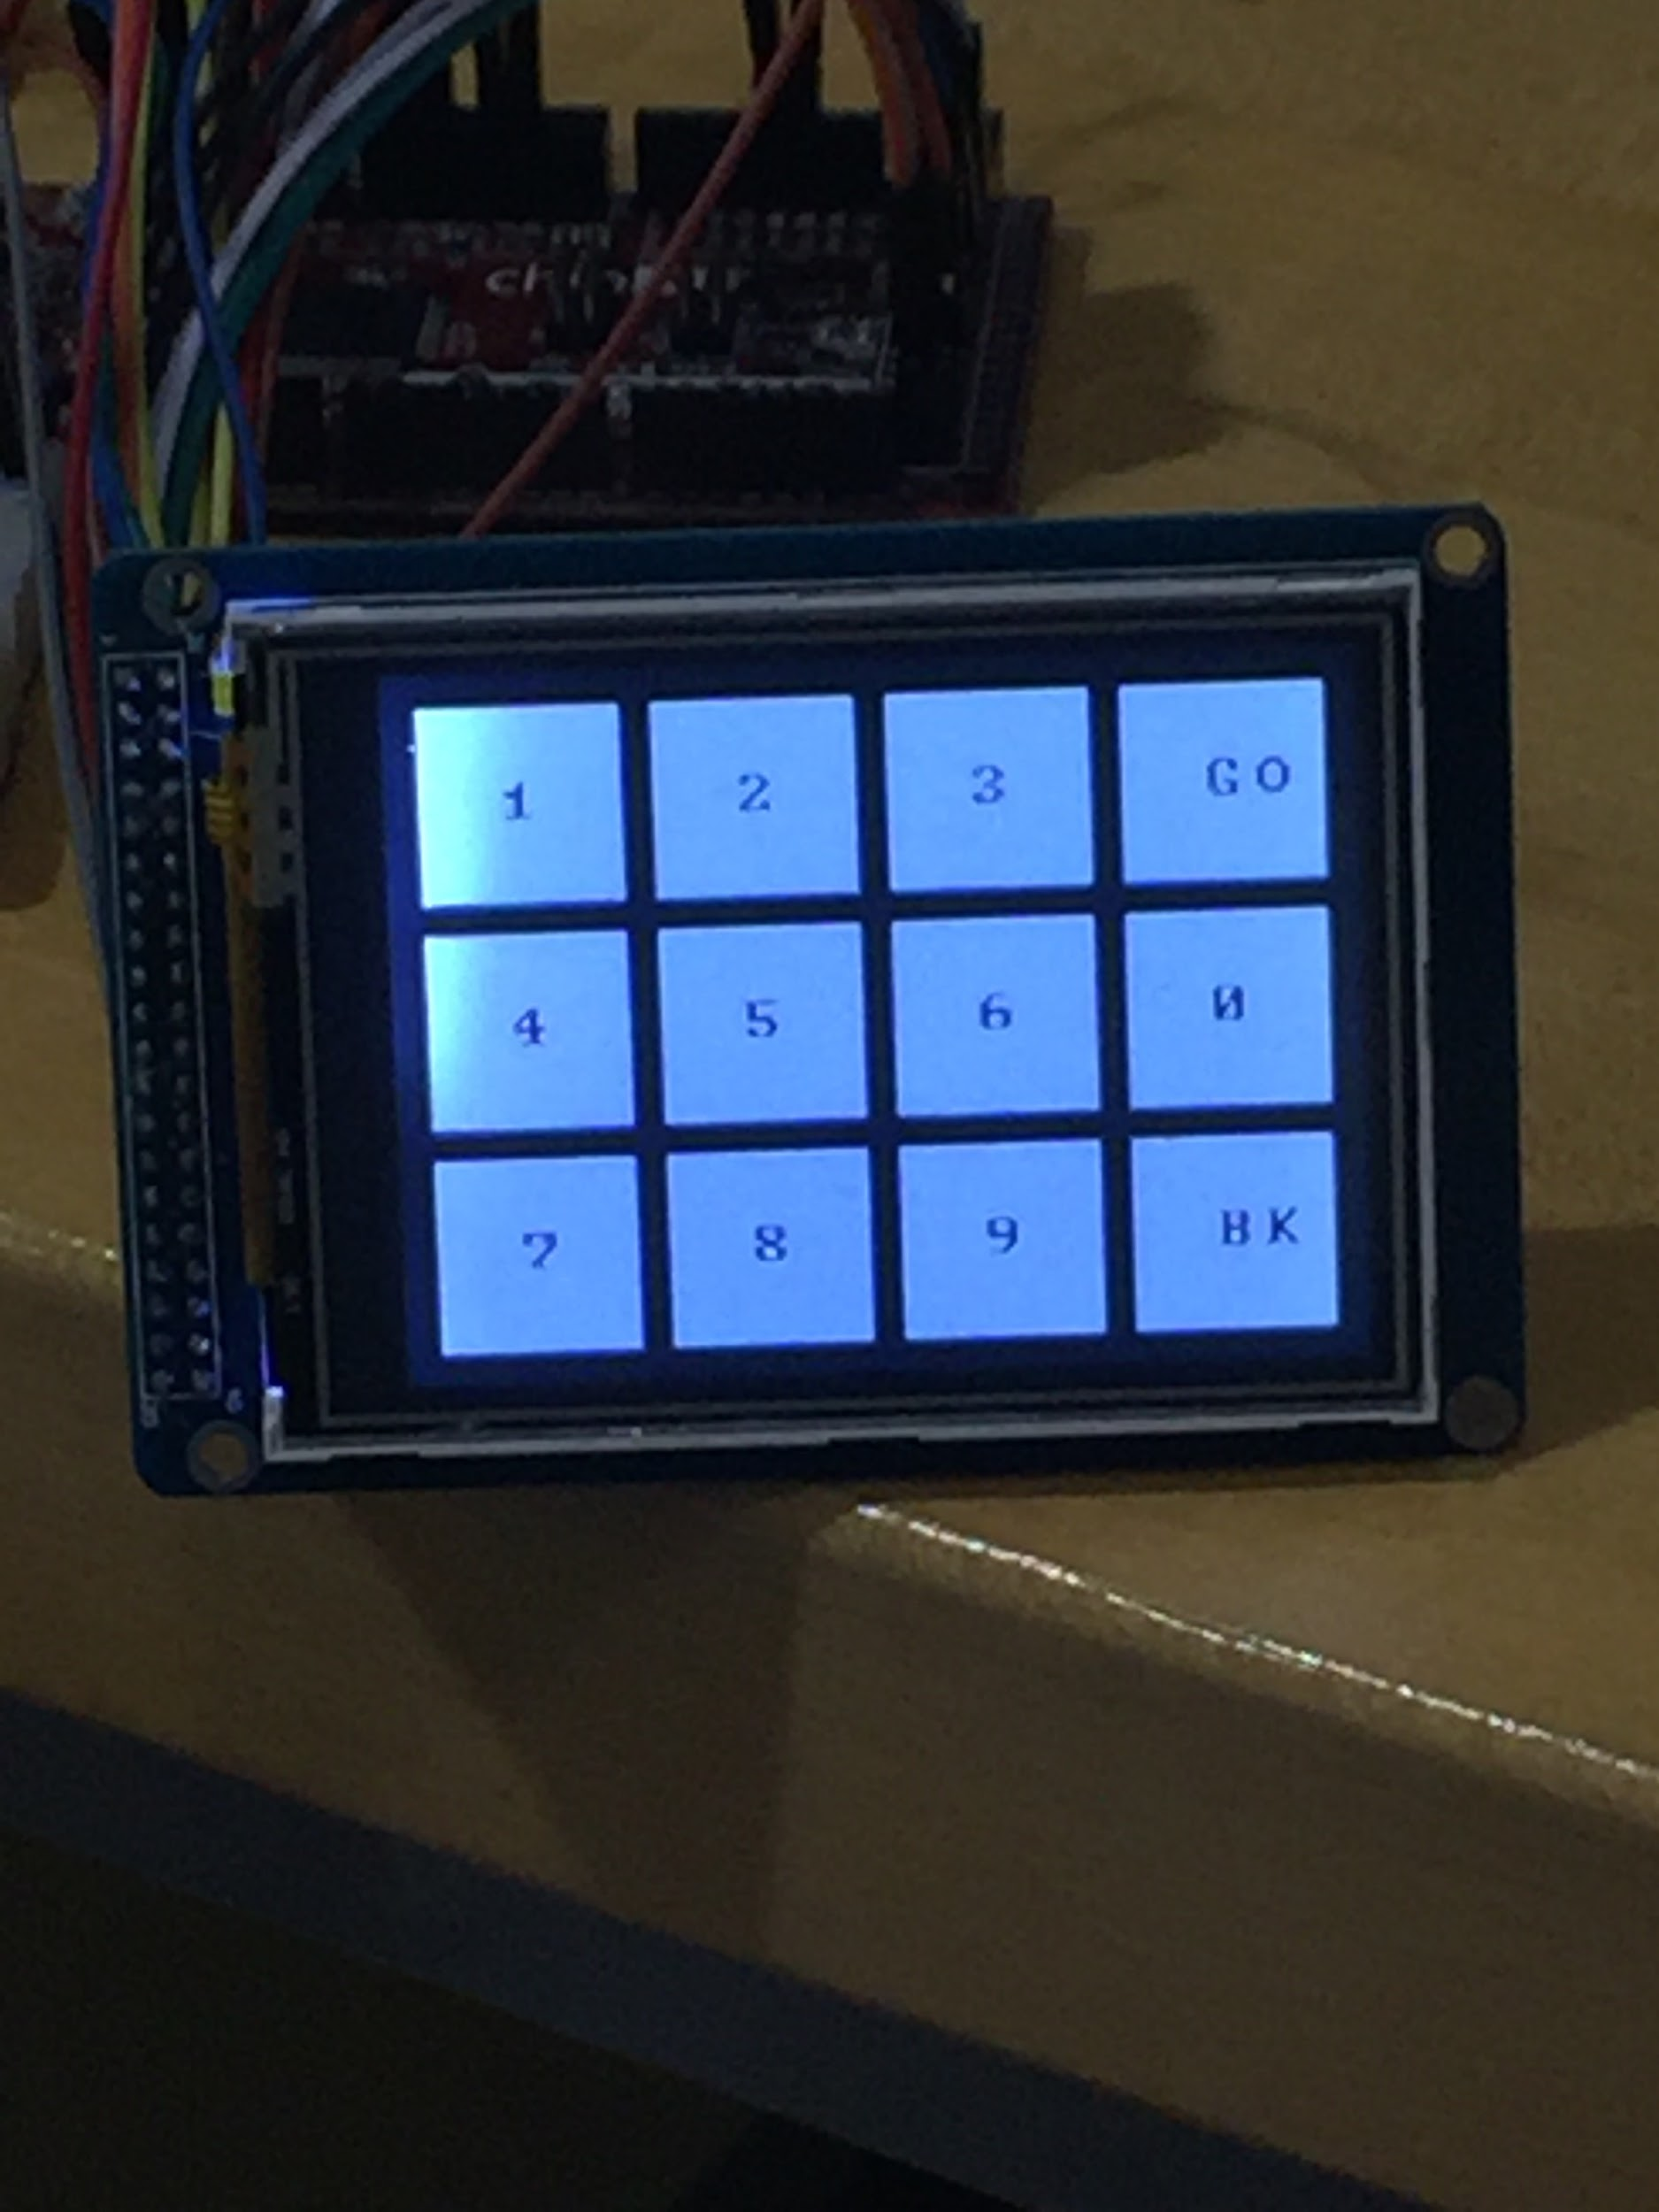
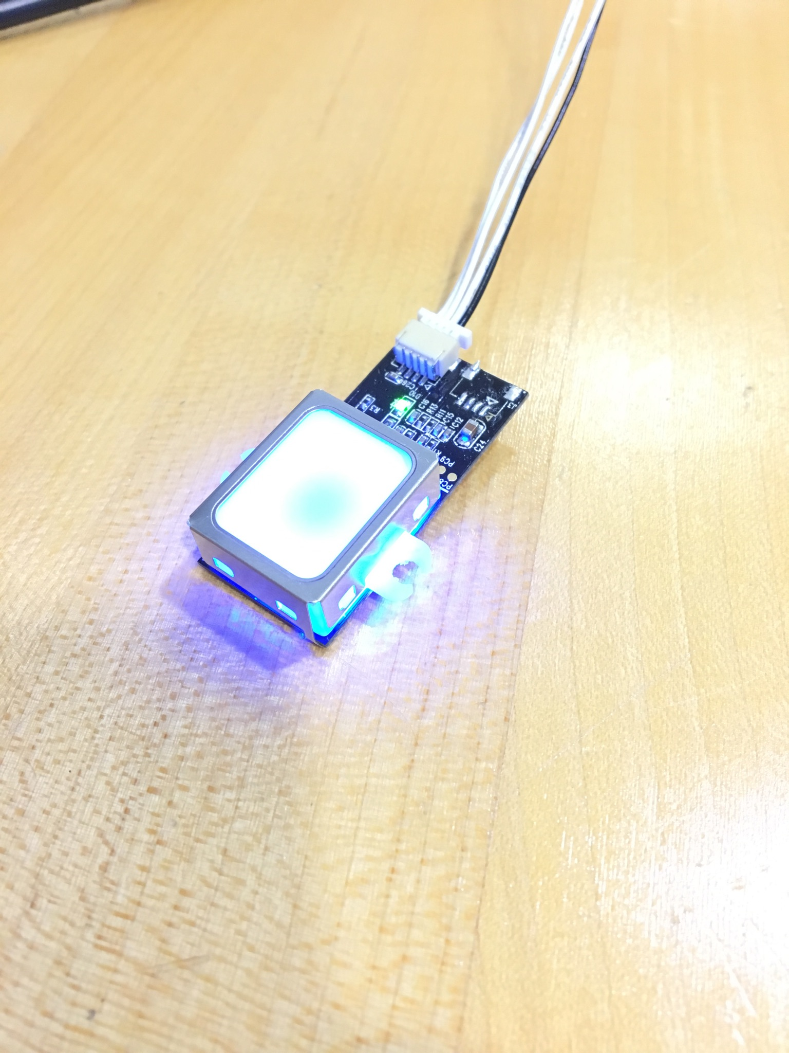
Group 25
U.S.S.R.
(Useful, Secure, Safe, Reliable)
Eric Dong, Julian Flores, Tyler Montague, Gabe Doyle
Operation Catapult 2017
Designing the Hardware
Introduction
The U.S.S.R. is a safe designed to protect the most precious items. It takes advantage of a two-layer security system which consists of a fingerprint sensor and an LCD touchscreen display.
Future Changes
Laser-cut acrylic box
LCD 3.2 in. touchscreen display
Fingerprint sensor
4 LEDs
Box made out of metal
Connect the LCD serially
Testing
How it Works
Conclusion
Testing began with testing our code with the LCD touchscreen display
Testing continued with testing code for the fingerprint scanner
The final components we tested were the LED lights
We merged the code to see if they would work together and they did
Place finger on fingerprint sensor
Keep finger on until LCD screen display turns on
Enter PIN into the LCD screen display
Open the door
It was extremely fun to see our project come to life. The obstacles we had to overcome while making this safe taught us not only how to problem solve, but how to work as an efficient team.

